Slide 1
Igneous Rocks

Slide 2
By the end of this lesson, you should be able to:
Discuss the process of how igneous rocks are formed.
Compare and contrast mafic and felsic igneous rocks.
Compare and contrast intrusive and extrusive igneous rocks.

Slide 3
Igneous rocks are formed from molten (liquid) rock.
Sometimes, molten rock rises up through the Earth’s crust as magma. It eventually cools down and crystallises to become solid rock.
In other words, igneous rocks are the remains of frozen magma!

Slide 4
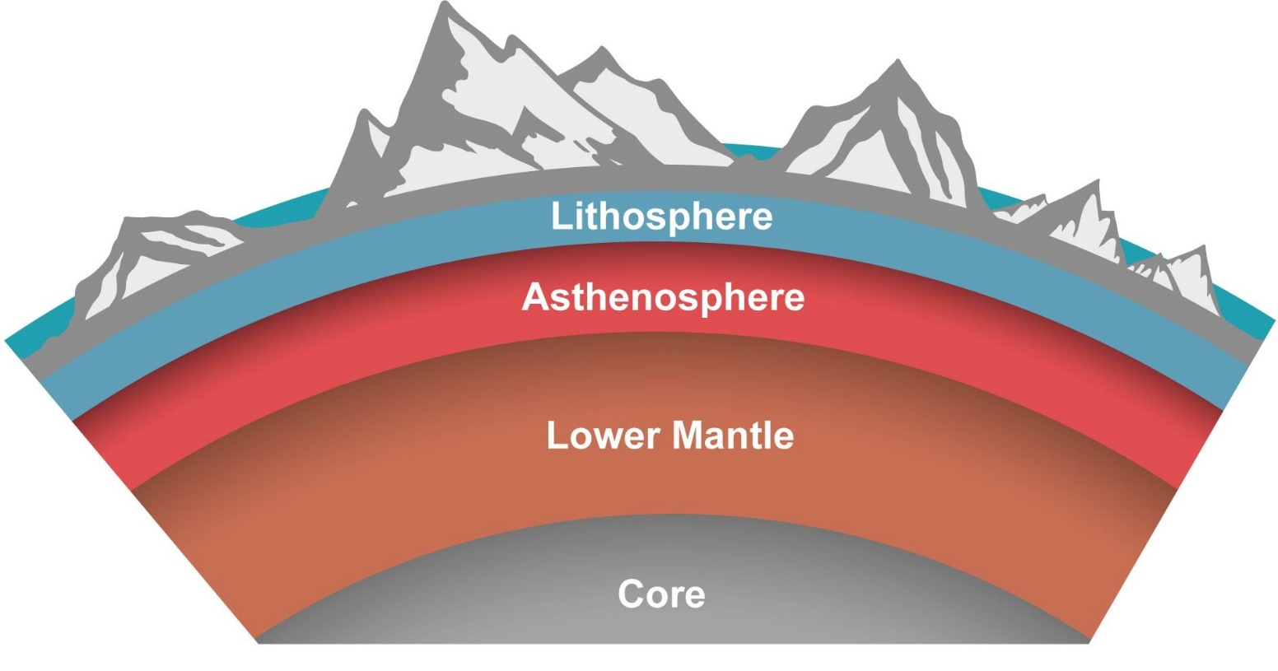
Magma is found in the layer below the Earth's crust.
This layer is called the mantle and, at 2 900 km thick on average, it is the thickest layer of the Earth!
The mantle is divided into the upper mantle and the lower mantle. The upper mantle is divided further into the lithosphere and the asthenosphere.

Slide 5
Igneous rocks are formed in some spectacular places, including volcanic islands!
Once it has risen to the Earth’s crust, magma has two options. It can either settle within the Earth’s crust, or (the more exciting option) erupt through the Earth’s surface as lava.
Lava is the really hot, burn-ey stuff that flows out of volcanoes! Like magma, it also cools and crystallises to form igneous rocks, but only on or above the Earth’s surface.

Slide 6

Igneous rocks were the very first type of rock that ever formed on Earth!
Much like when chocolate sets on ice cream, the first igneous rocks were formed when the young, molten Earth started to cool down and form its crust and mantle.
Both sedimentary and metamorphic rocks are formed from other rock types, so there couldn't have been any of these rocks before igneous rocks formed on the Earth.

Slide 7
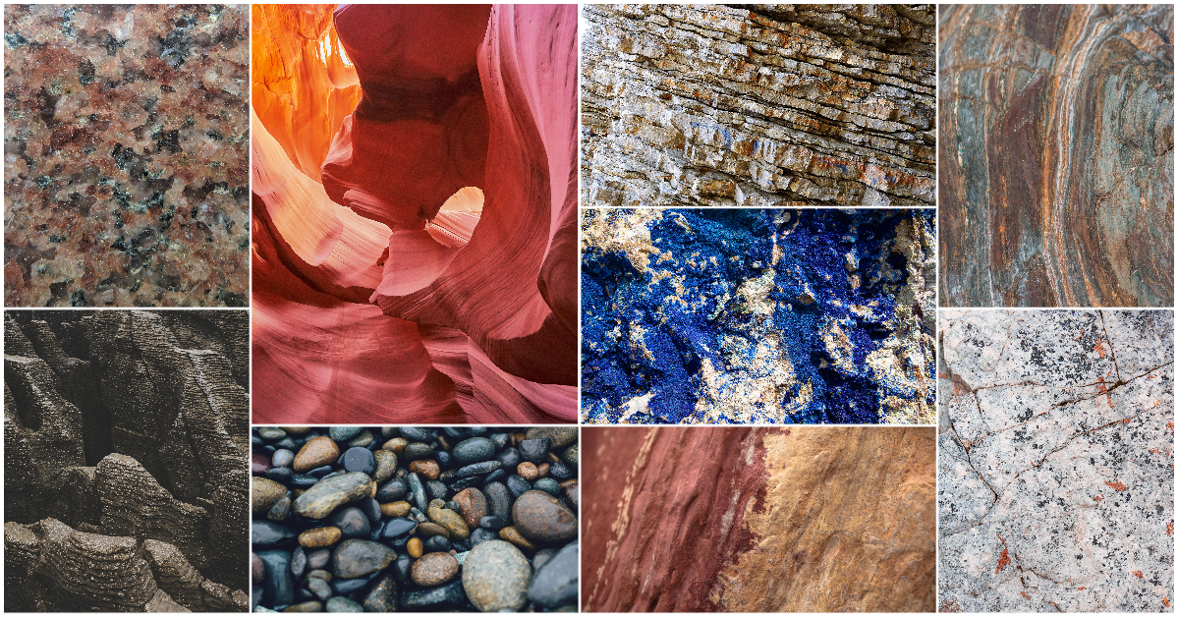
Geologists group, or classify, igneous rocks based on two key properties:
Composition
Texture

Slide 8
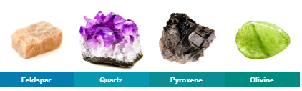
Igneous Rocks can be classified based on the minerals that they contain.
The terms “mafic” and “felsic” are used to describe igneous rock, based on their chemical composition.
The main minerals in igneous rocks are feldspar, quartz, amphiboles, pyroxenes and olivine.

Slide 9
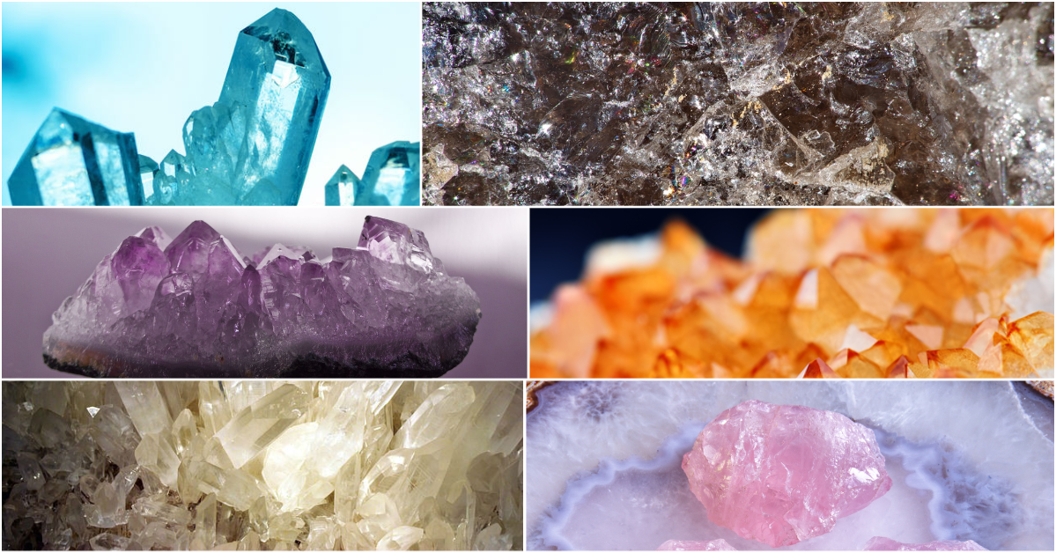
The classification of igneous rock as being either mafic or felsic is primarily based on the quartz content of the rock.
Igneous rock with between 45% and 55% quartz is classed as mafic, whereas igneous rock with over 65% quartz is classed as felsic.

Slide 10
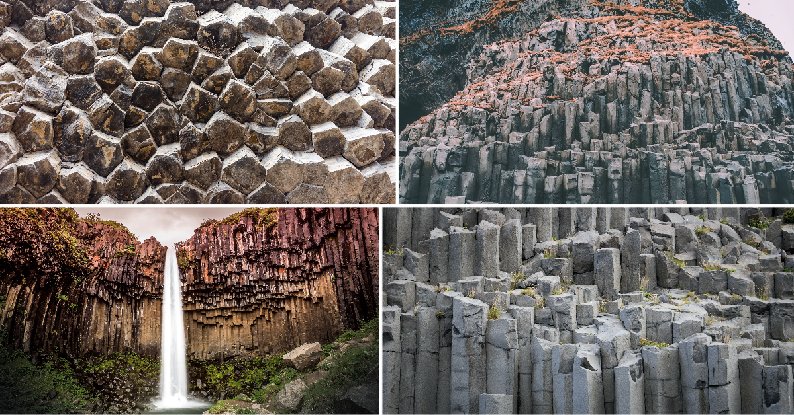
Typically, mafic rocks are dark in colour.
Mafic rock is typically very high in magnesium and iron, as well as the minerals olivine and pyroxene. In its molten form, mafic lava makes less explosive eruptions because of its low viscosity, allowing it to flow easily.

Slide 11
Felsic igneous rocks are typically much lighter in colour than mafic igneous rocks and are more porous.
This type of igneous rock typically has a high proportion of light-coloured minerals in its composition, including feldspar, quartz and muscovite.
Felsic lava is much more viscous than mafic lava. This means that the eruptions of felsic lava are much more explosive and the magma cools much quicker. Sometimes, this type of igneous rock is easier to identify as gas bubbles may have formed and have remained within the magma as it cools and solidifies.

Slide 12
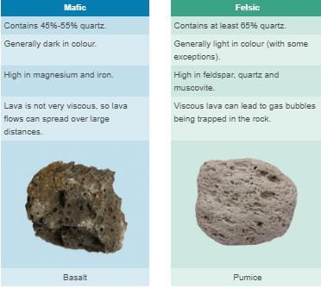

Slide 13
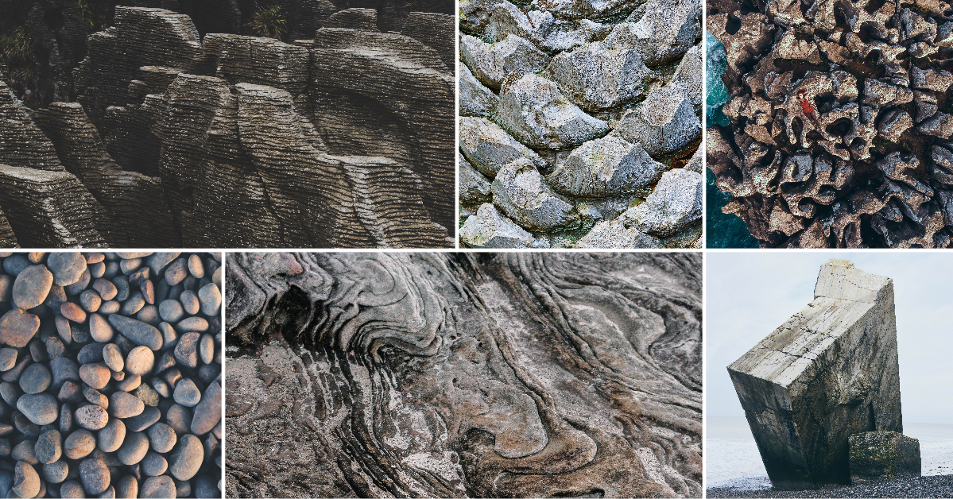
We can also classify igneous rocks based on their texture.
Texture describes how a rock looks or feels. It usually depends on the physical structure of the rock.

Slide 14
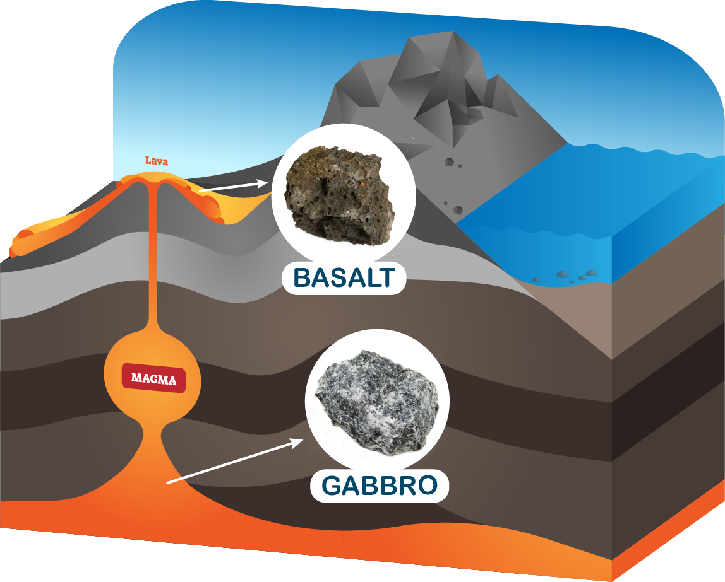
Intrusive rocks cool from magma deep underground. Extrusive rocks cool from lava on or above the Earth’s surface.

Slide 15
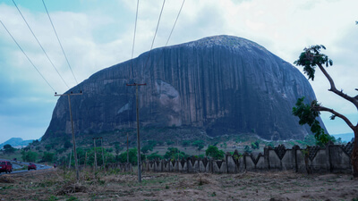
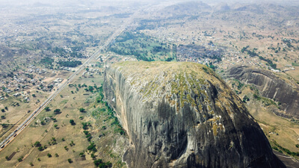
If magma solidifies when it is still below the Earth's surface, it forms intrusive igneous rocks like granite or gabbro.

Slide 16
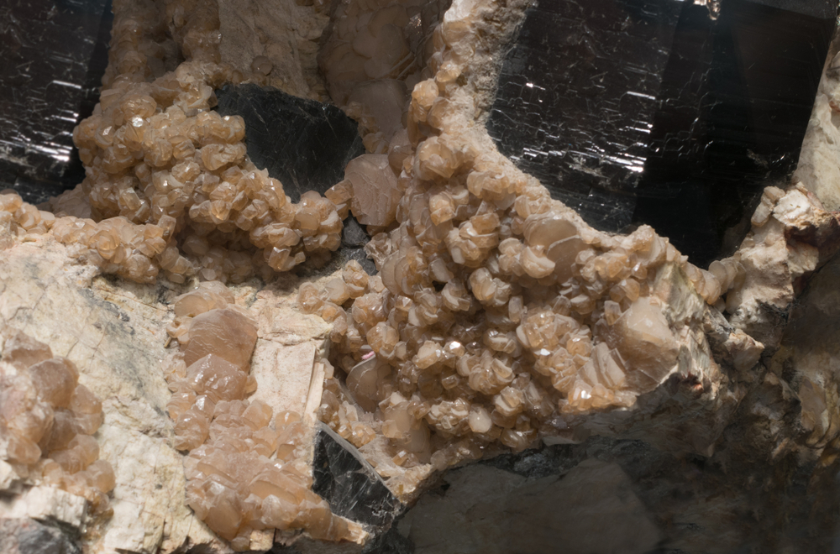
Intrusive igneous rocks have a coarse texture.
When these rocks cool from magma, crystals grow inside them.
Since they are trapped in the Earth’s hot interior, the cooling is slow and the crystals have lots of time to grow. Hence, the crystals in intrusive rocks tend to grow quite large.

Slide 17
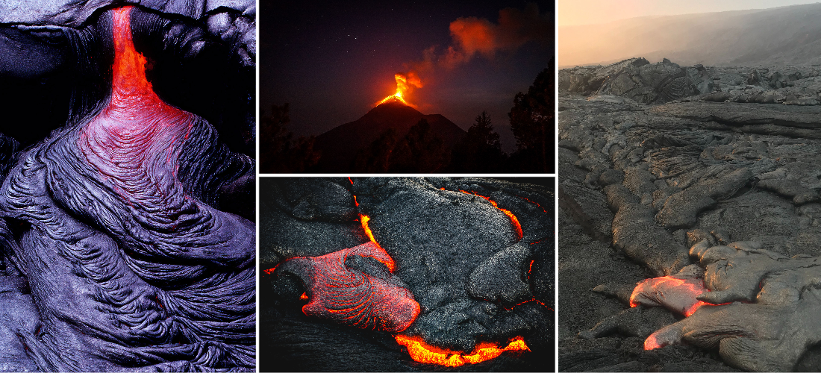
When lava cools and solidifies during a volcanic eruption, it forms extrusive igneous rocks.
The word ‘extrude’ means to squeeze out, like toothpaste being squeezed out of a tube.
Extrusive rocks are made from lava that is ‘squeezed out’ of a volcano!

Slide 18
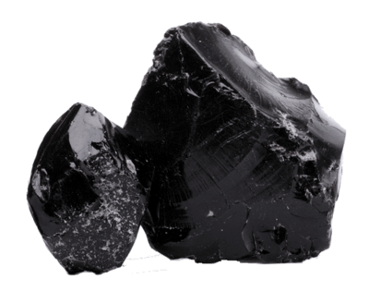
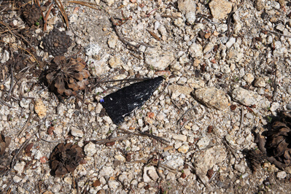
Extrusive igneous rocks have a fine texture made up of very small crystals.
These rocks solidify very quickly on the Earth’s surface, so the crystals inside have little time to grow.
Obsidian is a rock that cools so quickly it contains no crystals at all! This rock is, in fact, a type of natural glass.

Slide 19
